Slide 1
KNEMATICS OF MACHNERY Chapter 1 1st B. Tech_ Sem 2 Dr P SURESH APRIL – JUNE 2022 sureshp@nitw.ac.in 8248754482

Slide 2
Syllabus: Introduction to Mechanisms: Basic terminology, kinematic chains, Mechanisms, Degrees of freedom, Four bar chain - equivalents, inversions and their applications. Case studies on Straight line mechanisms, steering gear mechanisms and other general mechanisms. Kinematic Analysis of Planar Mechanisms: Position analysis of single degree of freedom mechanisms, range of motion, extreme positions, transmission angle and quick return ratio. Building blocks for Velocity and Acceleration analysis- sliding pair, turning pair and turn slide pair. Graphical and Analytical methods for the velocity and acceleration analysis of four bar, slider crank and other single degree of freedom mechanisms. Synthesis of Mechanisms: Dimensional synthesis, function generation, path generation and motion generation, Synthesis of single degree freedom closed loop mechanisms for specified Instantaneous conditions. Identification of available number of equations, input and output variables, design parameters and choice of free variables/parameters. Well-defined under constrained and over-constrained mechanism synthesis. Gears and Gear trains: Classification, Terminology, Law of Gearing, Interference and methods to avoid interference in spur gears. Simple, compound, reverted and cycloidal gear trains. Cams: Classification of cams and followers, applications, SVAJ (Plot position (s), velocity (v), acceleration (a) and jerk (j) versus cam angle) diagrams. Overview of motion programs and synthesis of cam profiles.

Slide 3
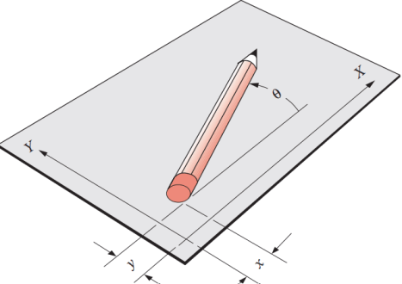
Pure rotation The body possesses one point (center of rotation) that has no motion with respect to the “stationary” frame of reference. All other points on the body describe arcs about that center. A reference line drawn on the body through the center changes only its angular orientation.
Pure translation All points on the body describe parallel (curvilinear or rectilinear) paths. A reference line drawn on the body changes its linear position but does not change its angular orientation.
Complex motion A simultaneous combination of rotation and translation. Any reference line drawn on the body will change both its linear position and its angular orientation. Points on the body will travel nonparallel paths, and there will be, at every instant, a center of rotation, which will continuously change location.
Translation and rotation represent independent motions of the body. Each can exist without the other. If we define a 2‑D coordinate system as shown in Figure, the x and y terms represent the translation components of motion, and the θ term represents the rotation component

Slide 4
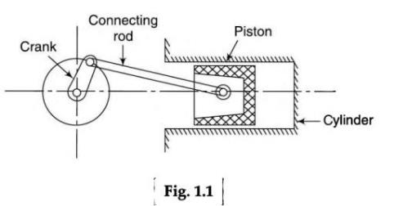
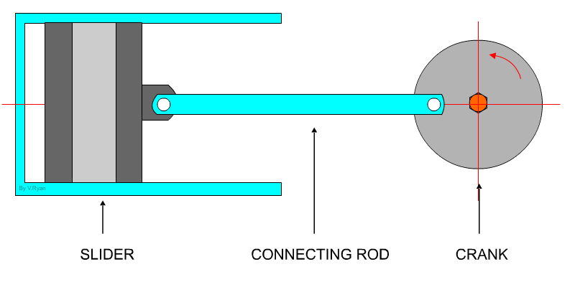
A kinematic chain is defined as: An assemblage of links and joints interconnected in a way to provide a controlled output motion in response to a supplied input motion.
A mechanism is defined as: A kinematic chain in which at least one link has been “grounded,” or attached, to the frame of reference (which itself may be in motion).
A machine is defined as: A combination of resistant bodies arranged to compel the mechanical forces of nature to do work accompanied by determinate motions.
Kinematics is a branch of science, which deals with motions of various points and their relationships, without giving any reference to the forces, which are responsible for causing the motions.
Thus it’s study from geometric point of view displacement, velocity and acceleration.
Dynamics: It deals with evaluation of forces impressed upon different parts of mechanism. The forces can be either static or dynamics.
Kinetics is the study of forces when body is in motion
Statics is the study of forces when body is in stationary.

Slide 5
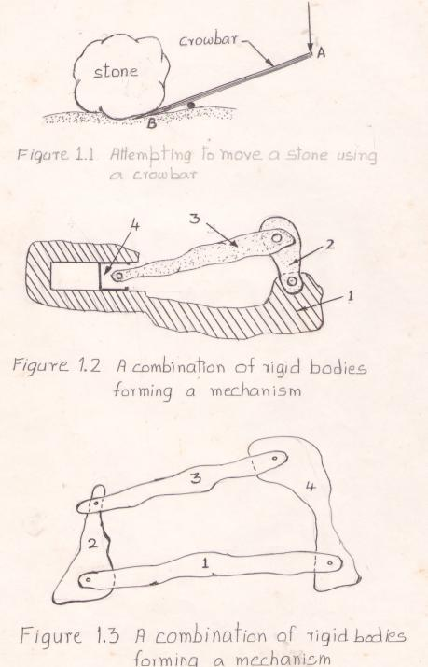
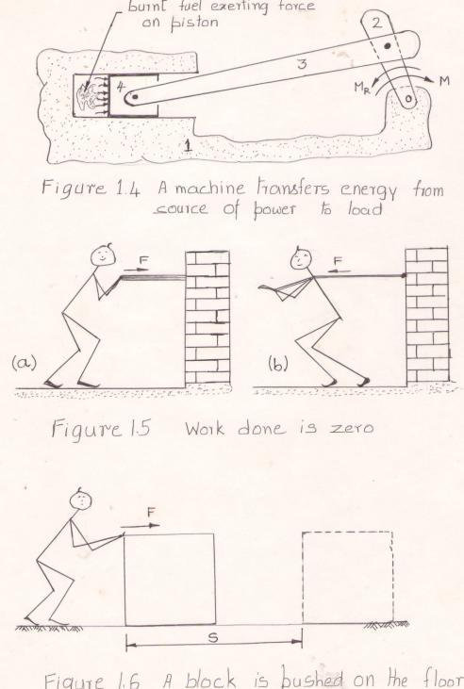
If the point A moves by a known amount, by how much amount the point B moves?
If the motion of the point A is taking place at a known amount of velocity, what would be the velocity of point B ?
Knowing the velocity of point A, can you tell the angular velocity of rotation of the crowbar about the pivot?
If the acceleration of point A is known, what will be the acceleration of point B ?
If the point A is made to move along a particular path (curve), in a plane perpendicular to the plane of paper, what will be the curve followed or traced by point B?
It is to be observed that one is trying to relate the motions of points A and B. No doubt, there is a force involved, which is responsible for causing these motions. But there is no need to consider the force. The above questions may easily be answered by considering the properties of similar triangles.
Identify some flexible bodies.
An object, which may be considered as a rigid body in a particular application, may not be in some other application. Give an example to explain this fact.
if it is a , the crank rotates the armature of an electric generator producing electric power which is fed to various electrical appliances
if it is an , the crank rotates the wheels and the vehicle is made to move on the road
if it is a , the crank rotates the impeller of the pump and the water is lifted to greater heights.

Slide 6
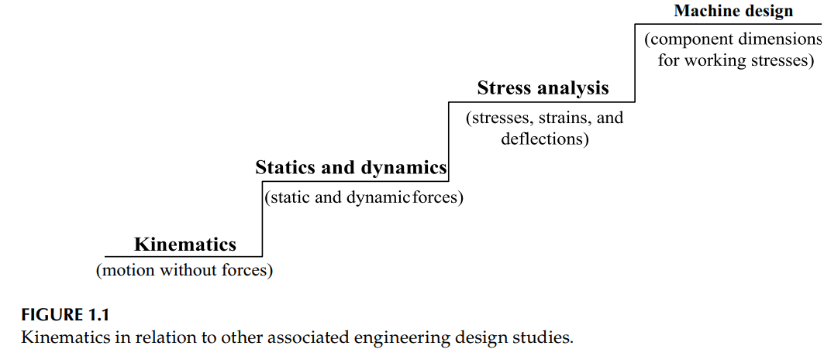
Kinematics is the study of motion without considering forces. In a kinematic analysis, positions, displacements, velocities and accelerations are calculated for mechanical system components.
In comparison to other engineering design studies such as statics, where motion and governing loads are considered according to Newton’s first law.
Dynamics, where motion and governing loads are considered according to Newton’s second law, kinematics is the most fundamental engineering design study.
• Static or dynamic loads acting on the components (considered in statics and dynamics) • Component material stress and strain responses to the loads (considered in stress analysis)__ Design of Machine Elements • Required component dimensions for the working stresses (considered in machine design) __ Design of Transmission Elements
kinematic analysis would be revealed as excessive acceleration in a dynamic analysis, which, in turn, could produce excessive dynamic forces.
These excessive dynamic forces would likely produce high stresses. These high stresses may require a material selection or component dimensions that make the overall component design impractical for the intended design application.
Kinematic study must be done first before considering the follow-on engineering design studies

Slide 7
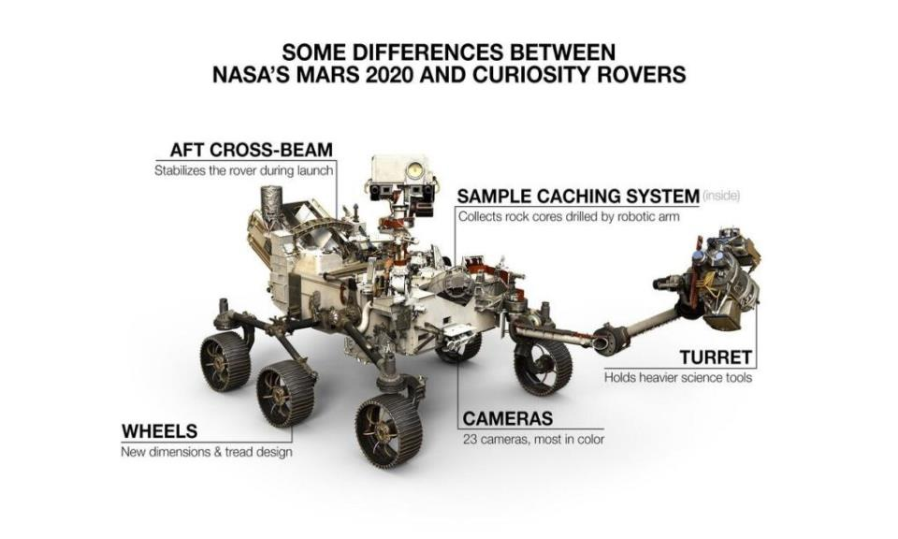
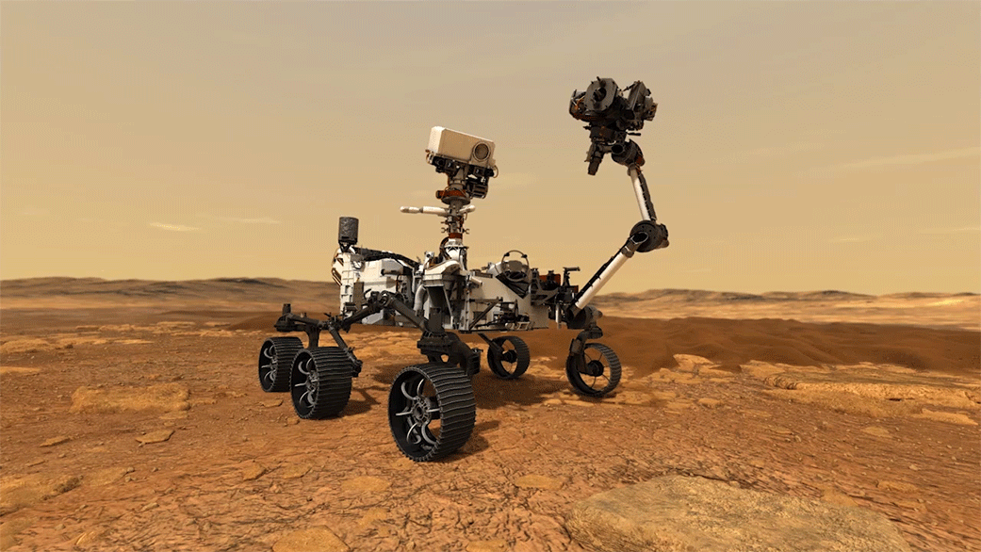
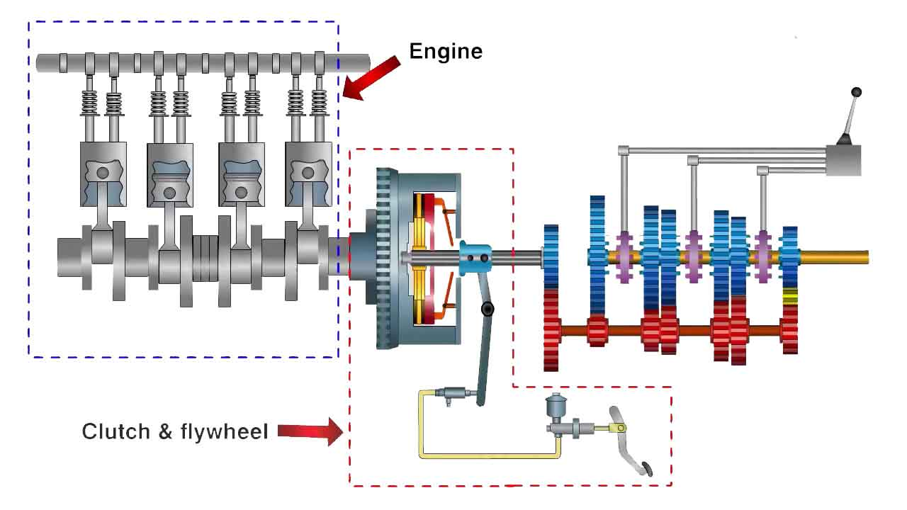

Slide 8
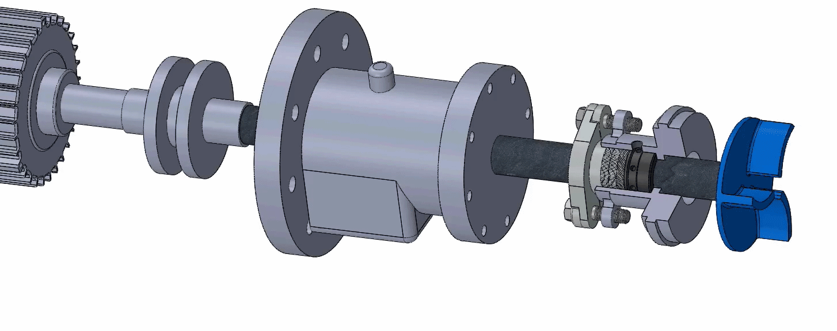
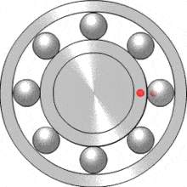
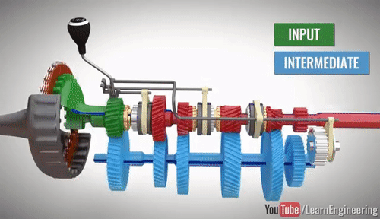
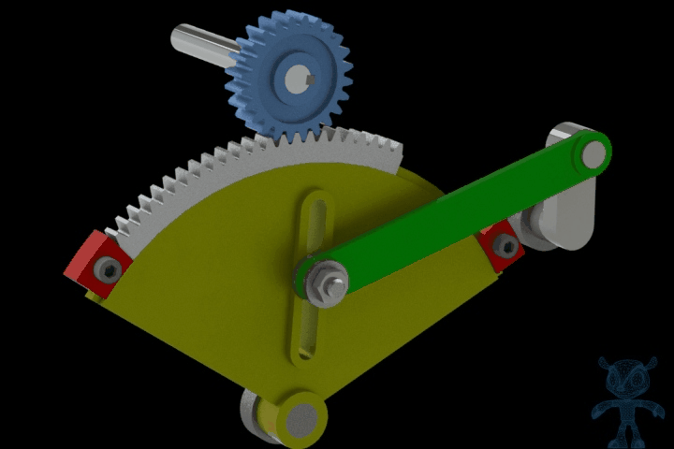

Slide 9
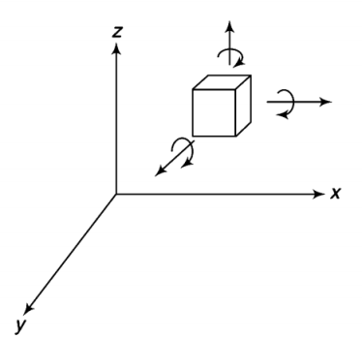
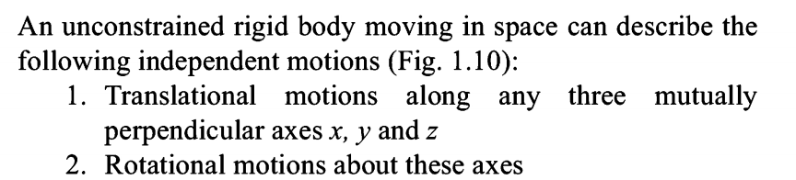
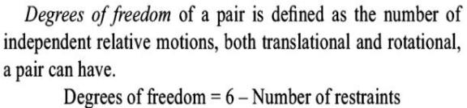
Degree of Freedom

Slide 10
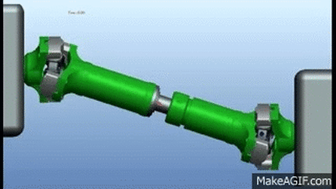
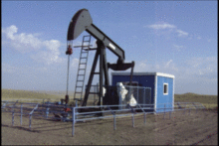
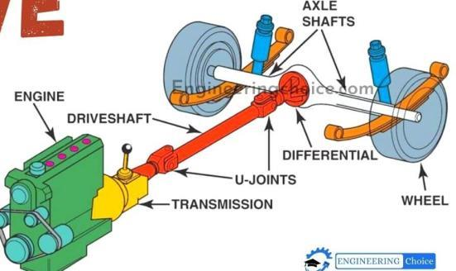
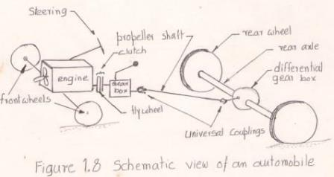
Space Mechanism : Some points in a mechanism moves in three –dimensional space Example : Hook’s joint (universal coupling)
Four bar Mechanism
(Planer Mechanism)
Kinematic Pair: is a joint between two links
(How they are joined ?)
Also, the relative motion between this two links is depends on the joint or kinematic pair .
It’s classified into : LOWER and HIGHER PAIR

Slide 11
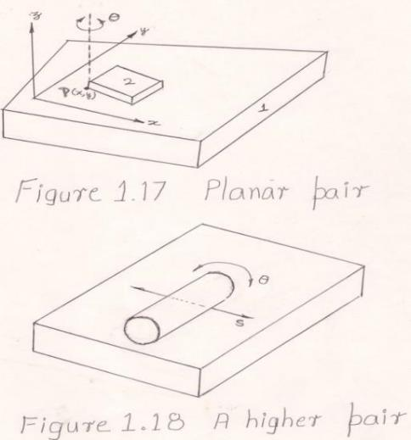
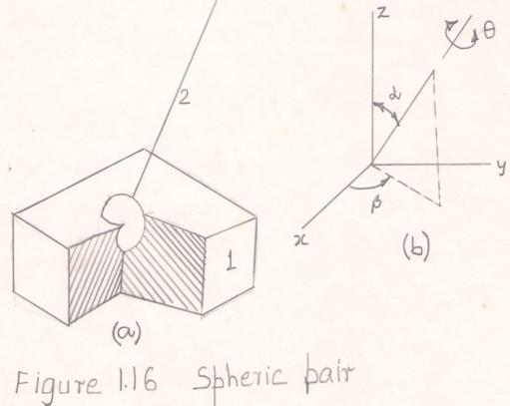
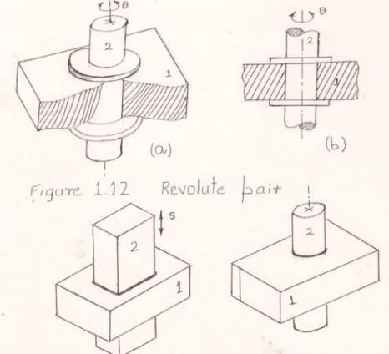
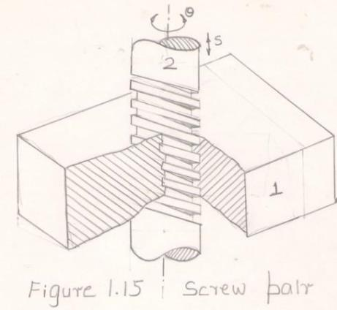
Kinematic Pair
Lower Pair
Revolute Pair: Prevent the axial movement of link 2, but rotates about own axis. This pair has only one degree of freedom
Planer Pair: Block (link 2) slides over link1 freely. Also, fix one corner then it rotates freely. Hence, 3dof.
Higher Pair:
The cylinder makes line contact and it will sliding (s) and rotating (theta), hence 2dof. Also, planner mechanism
Prismatic pair:
Prevent the rotational movement of link 2, but slide about axial direction.
This pair has only one degree of freedom
Cylinderical Pair
Fig. 1.12, the link 1 without flange. Now, the link has rotary and sliding motions. 2DOF.
Screw Pair: Free rotary motion can be done, during that liear motion happened , these are dependent co ordinates. Hence, DOF 1
Spheris Pair: Stem rotates own axis theta. Stem can tilt 0 to 90 degree at y z plane. Also, spherical part of link 2 rotates 360 in xy plane. Hence, 3dof

Slide 12
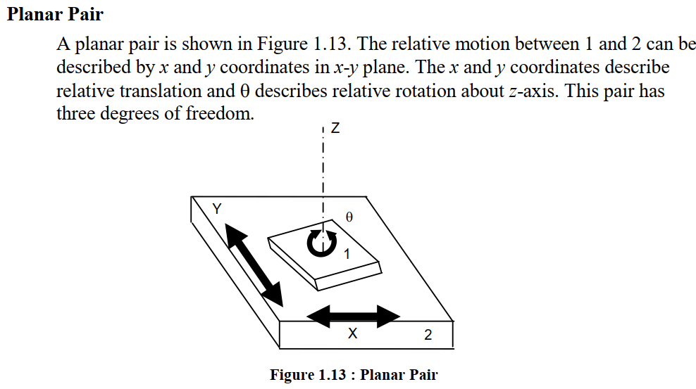
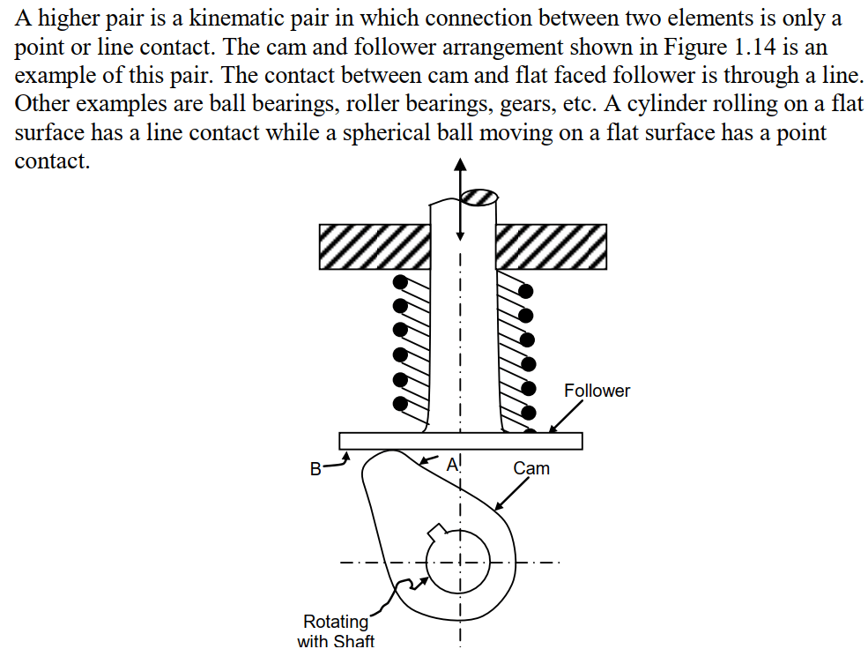
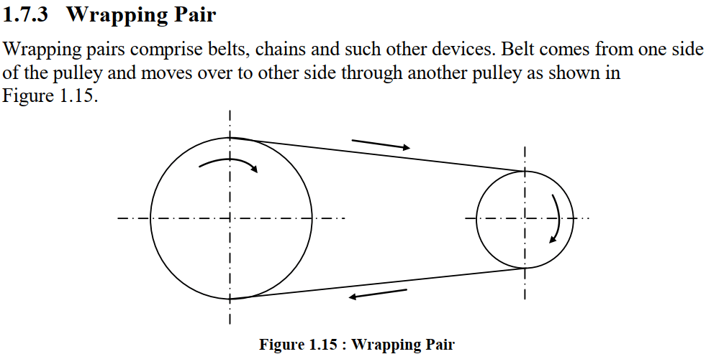
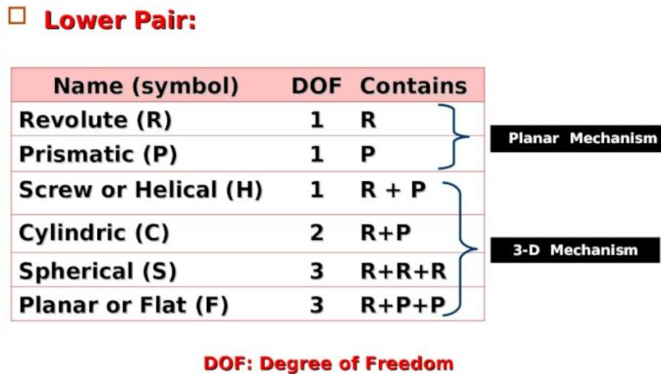
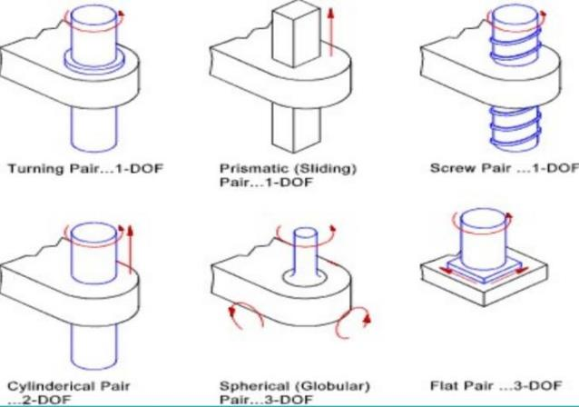
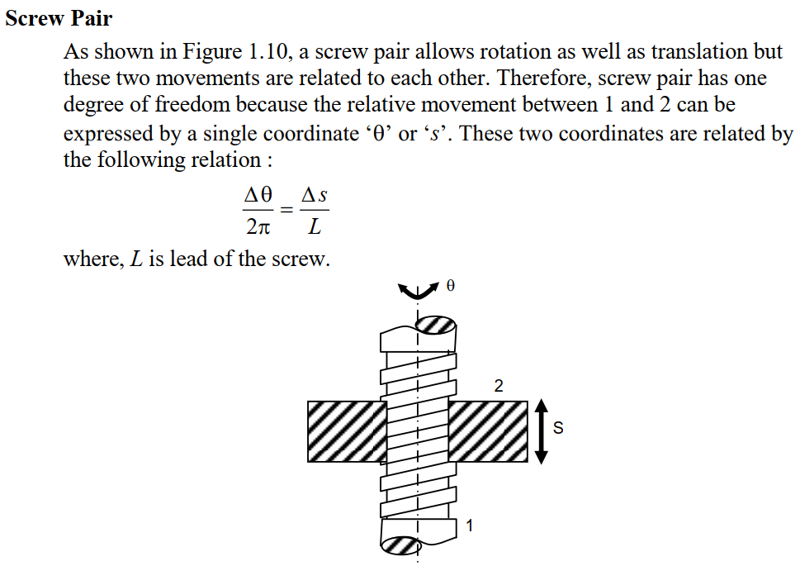
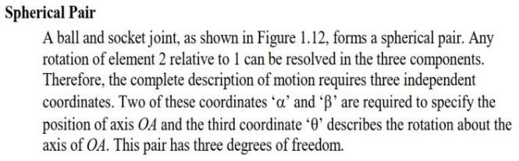
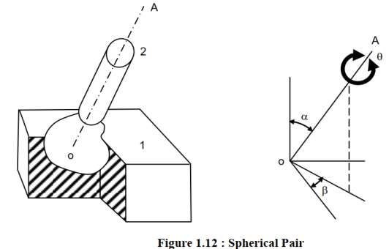

Slide 13
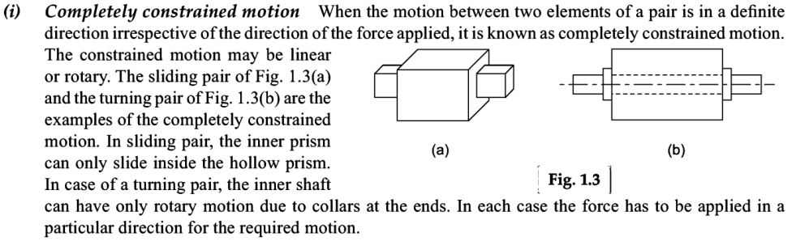
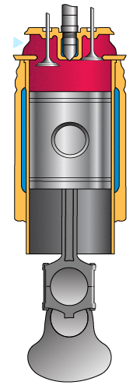
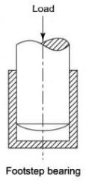
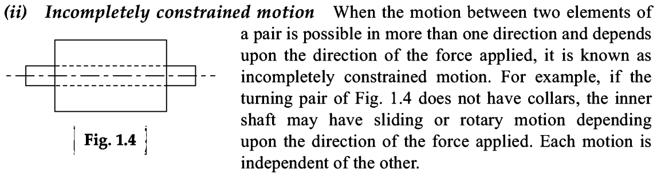
Types of Constrained Motion
Successfully Constrained Motion: When the motion between two elements of a pair is possible in more than one direction but its made have motion in only one direction. (Load applied to move the journal in only one direction)

Slide 14
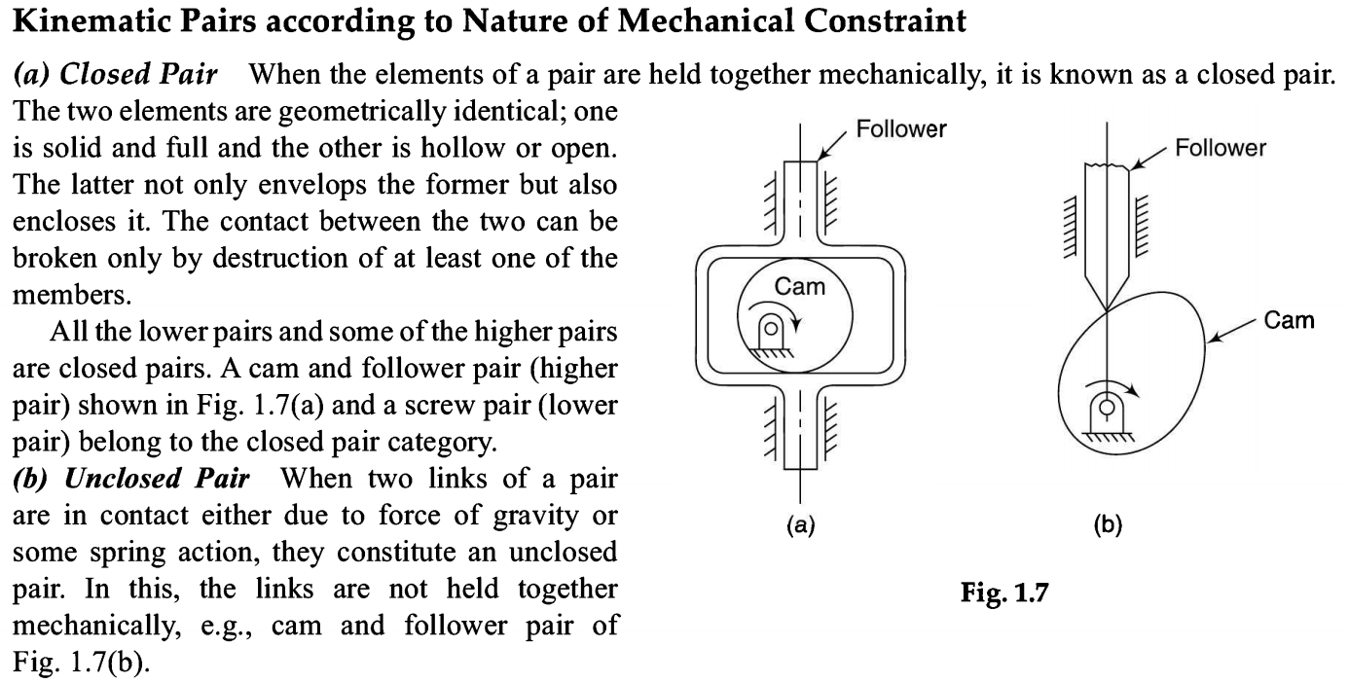

Slide 15
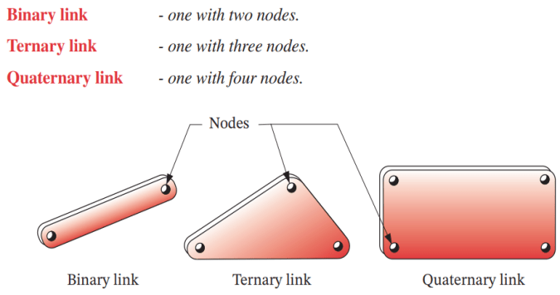
LINKS, JOINTS, AND KINEMATIC CHAINS
Linkages are the basic building blocks of all mechanisms.
Linkages are made up of links and joints.
We are going to discuss that all common forms of mechanisms (cams, gears, belts, and chains) are in fact variations on a common theme of linkages.
A link, as shown in Figure, is an (assumed) rigid body that possesses at least two nodes that are points for attachment to other links.

Slide 16
A joint is a connection between two or more links (at their nodes), which allows some motion, or potential motion, between the connected links. Joints (also called kinematic pairs) can be classified in several ways:
By the type of contact between the elements, line, point, or surface.
By the number of degrees of freedom allowed at the joint.
By the type of physical closure of the joint: either force or form closed.
By the number of links joined (order of the joint)
The term lower pair to describe joints with surface contact (as with a pin surrounded by a hole).
The term higher pair to describe joints with point or line contact.
However, if there is any clearance between pin and hole (as there must be for motion), so‑called surface contact in the pin joint actually becomes line contact, as the pin contacts only one “side” of the hole.
The main practical advantage of lower pairs over higher pairs is their better ability to trap lubricant between their enveloping surfaces.

Slide 17
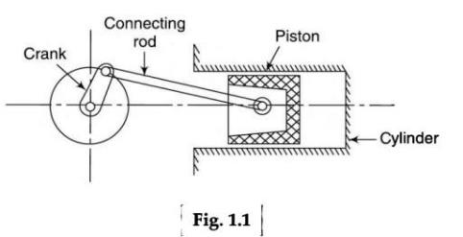
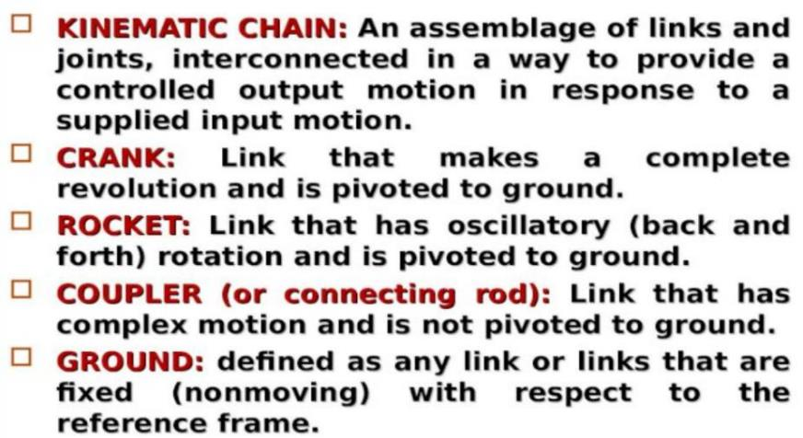
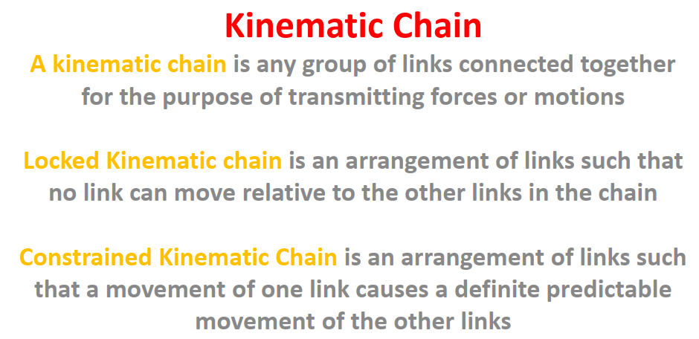
Planer Motion

Slide 18
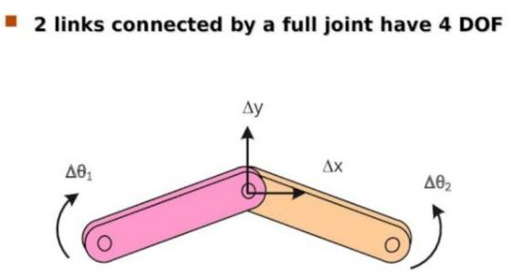
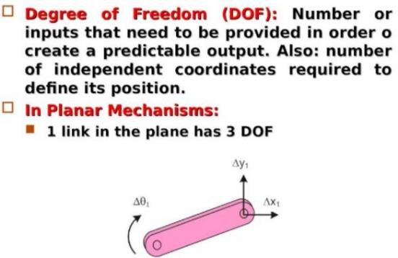
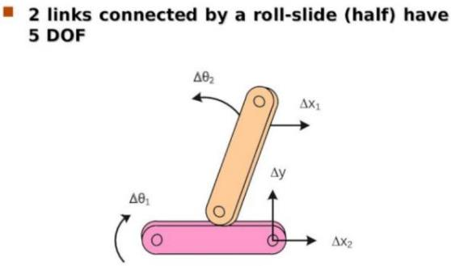
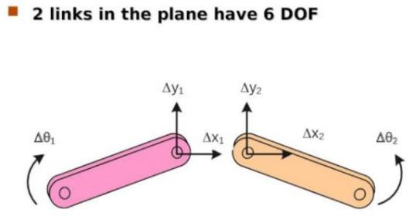

Slide 19
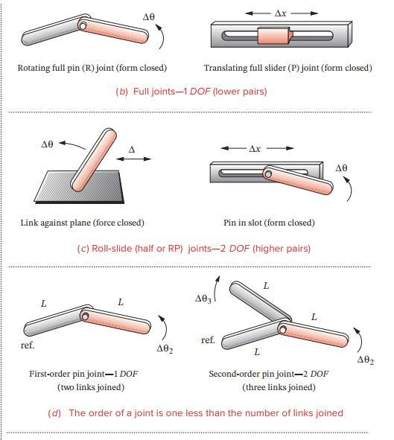
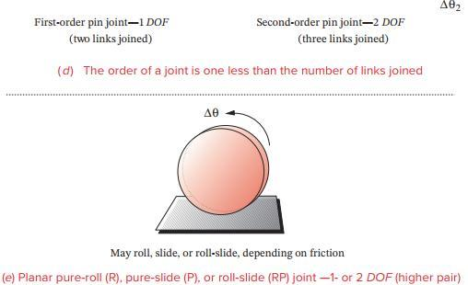

Slide 20
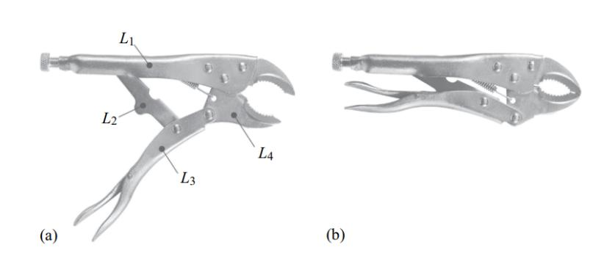
Moving the lower handle (link L3) toward the upper handle (link L1) or vice versa compels the motion of the remaining links, including the lower grip (link L4), which produces a gripping action.
The motion of each other link in a controlled manner is important because the fundamental objective in the design of a mechanical system is to provide a controlled output motion in response to a supplied input motion.

Slide 21
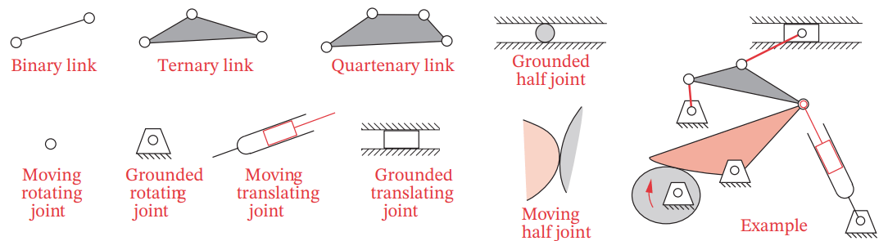
KINEMATIC DIAGRAMS
Analyzing the kinematics of mechanisms requires that we draw clear, simple, schematic kinematic diagrams of the links and joints of which they are made.
Sometimes it can be difficult to identify the kinematic links and joints in a complicated mechanism.
KINEMATIC REFRESNTATION

Slide 22
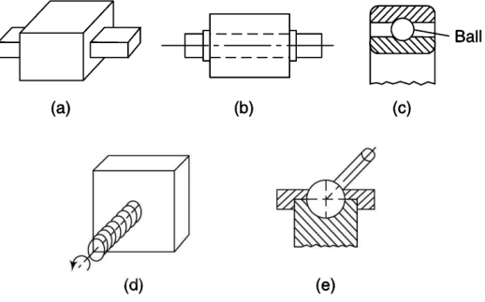

Find the Types of Pair, DOF and Joints ??

Slide 23




Slide 24




Slide 25




Slide 26




Slide 27





Slide 28




Slide 29
Mobility of Mechanism
Any one of links of the redundant chain is fixed that system is called structure or locked system.
For the constrained motions of the links of mechanism is based on the input .
Perhaps one input is given, that determines the constrained motions of other links and said to have 1 dof.
If two inputs are given, that determines the constrained motions of other links and said to have 2 dof, 3, 4, …
The DOF of structure or locked system is 0
If structure is negative DOF is called as superstructure.
In a particular mechanism, some of the restraints provided on a individual links are common or general to all the links of the same mechanism. Based on the common restraint, the mechanism can be classified into different order of mechanism.
Zeroth order: No common constraint.
1st order: 1 common constraint
2nd order: 2 general or common constrains and so on, upto 6th order..
But, mechanism is impossible at 6th order constraint, because going to be in stationary.

Slide 30


The above equation can be used to find the DOF as space mechanism
Most of the mechanism in two dimensional Ex: 4 link or 4 bar mechanism , Slider crank mechanism (Planer mechanism) “Gruebler’s Criterion”

Slide 31

This equation applicable to linkage with single DOF is called “Kutzback’s eqn”

Slide 32




Slide 33




